Slide 1

PATTERNS AND TRENDS IN PRO BONO SERVICES: LEVERAGING DATA ANALYTICS FOR THE AMERICAN BAR ASSOCIATION
Presented by Team 15: The Insightful Ones

Slide 2
AGENDA
Client Introduction
The Challenges
Our Insights
Summary of Recommendations

Slide 3
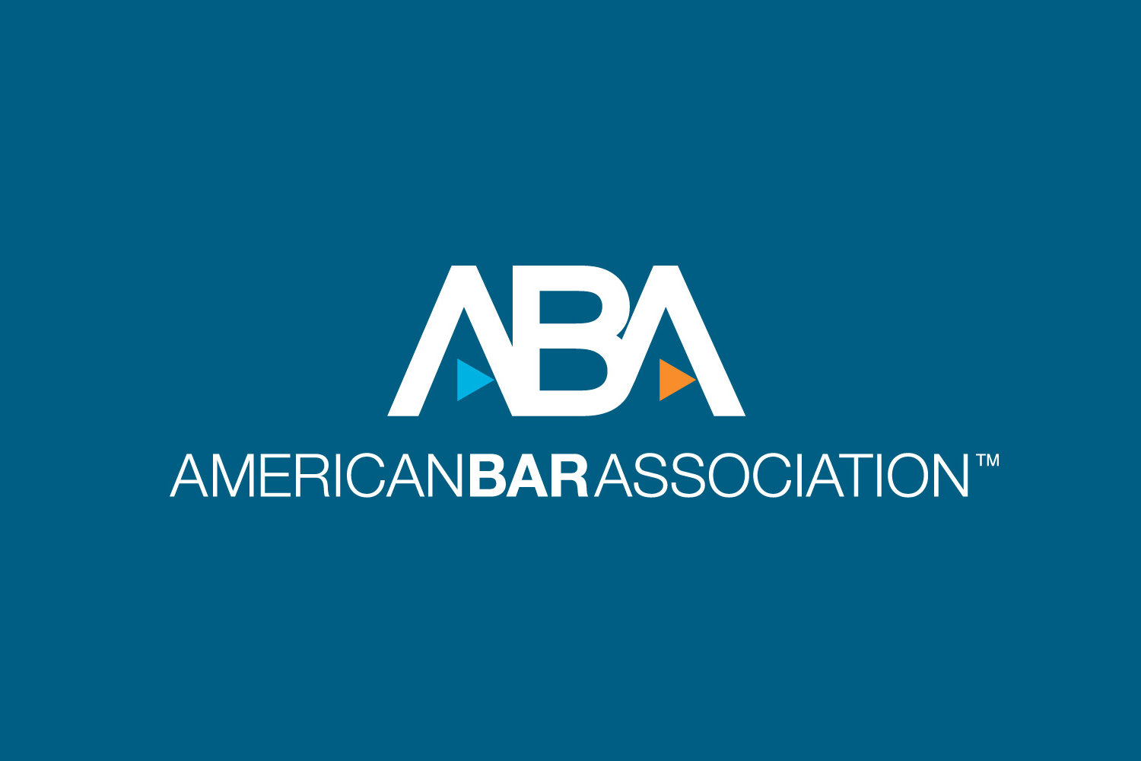
THE CLIENT:
THE AMERICAN BAR ASSOCIATION STANDING COMMITTEE ON PRO BONO & PUBLIC SERVICES
The American Bar Association is a voluntary professional organization committed to improving the legal profession and promoting access to justice.
Through its pro bono programs and initiatives, the ABA provides free legal services to underserved communities and aims to increase access to legal services for all Americans.

Slide 4



CLIENT'S PAINPOINTS
Lack of Awareness of their Pro Bono Service
Limited Resources and Capacity
Difficulty in Identifying User Needs

Slide 5



A BREAKDOWN OF THE PROBLEM
Limited Resources and Capacity
What time and place is the legal service most needed?
What user characteristics can be used to predict the category of questions that users ask?
Which specific areas of legal expertise should ABA seek in volunteer attorneys?

Slide 6
Insight 1: High demand of legal services between 2PM and 10PM; shortage of volunteers in Texas and Florida
Insight 2: Issues regarding Family and Children, and Housing and Homeless are becoming increasingly popular
Insight 3: Individual rights & Income Maintenance Law are low in proportion of total number of questions but high in proportion of unanswered question.
QUICK SUMMARY OF
INSIGHTS

Slide 7
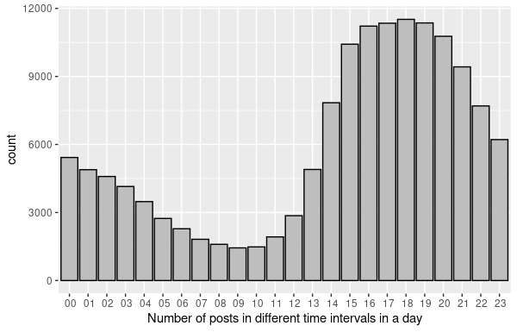
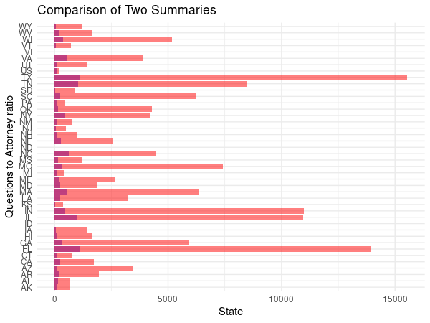
INSIGHT 1:
Peak hours: 14:00-22:00
Recommendation: allocate more volunteers during peak times to ensure clients receive prompt responses to their inquiries
South Dakota and Arizona have the highest shortage of lawyers, each with a case-to-attorney Ratio of 34.54 and 32.91, respectively
Alabama and Pennsylvania have the lowest ratio of 4.83 and 4.95 respectively
Recommendation: promote fair distribution of legal resources to handle the caseload

Slide 8
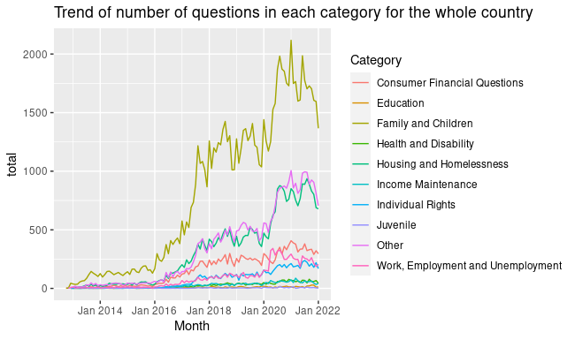
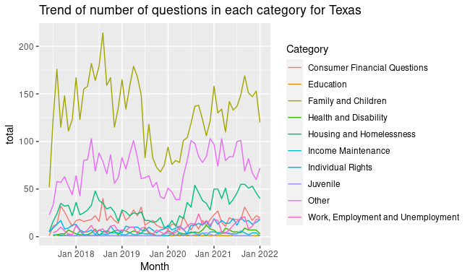
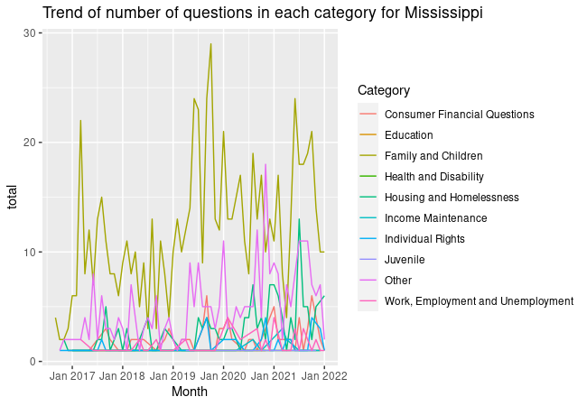
INSIGHT 2
Family and children law & Housing and Homelessness law are the most frequent categories in the US.
All categories shows consistent increasing trend.
Pattern are consistent for Texas and Mississippi.
Recommendation:Hire additional attorneys who possess specific expertise in Family and children law & Housing and Homelessness law.

Slide 9
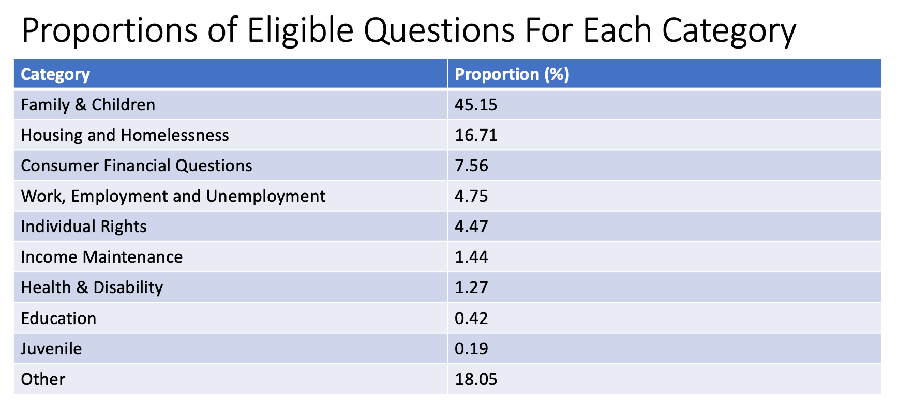
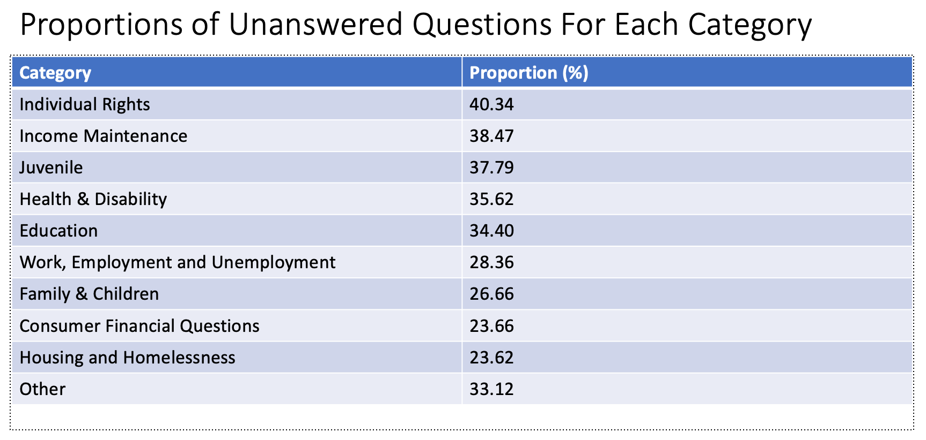
INSIGHT 3
Individual rights & Income Maintenance law are low in proportion of eligible question but high in proportion of unanswered question.
Recommendation: Introduce training programs that focus on developing law skills in Individual Right & Income Maintenance.

Slide 10
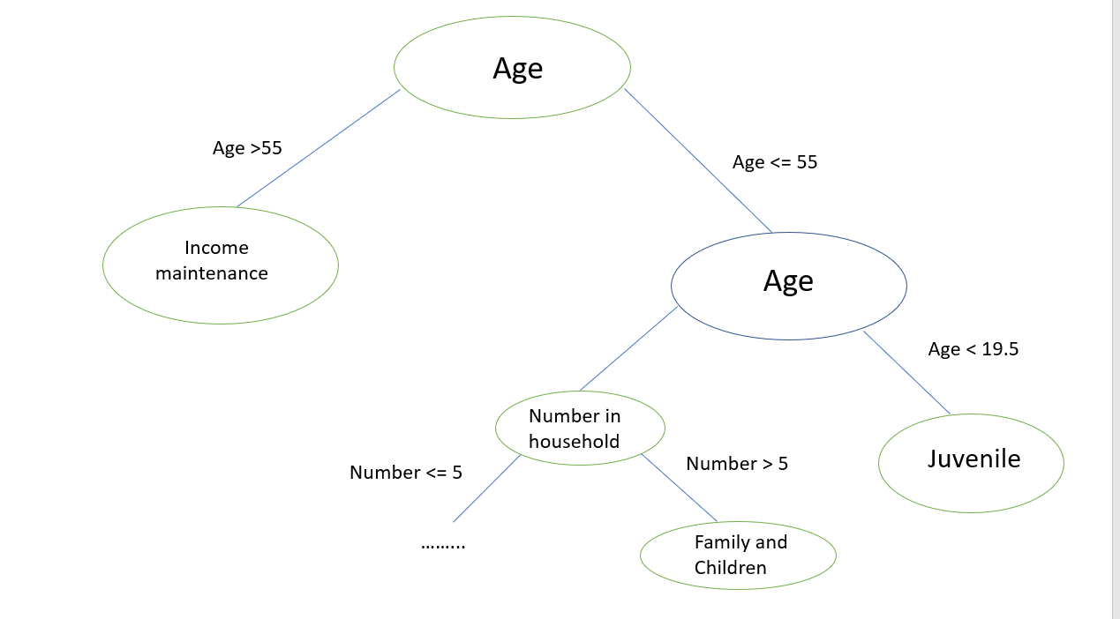
THE PREDICTION MODEL
1. Aim to predict potential clients' question category based on their characteristics
2. Specifically focused on Linear Discriminant Analysis and Quadratic Discriminant Analysis to classify
3. Estimated classification rule based on age and number of people in household yields a leave-one-out CV error rate of 46.5%
Limitations
1. Normality assumptions could be violated due to nature of data
2. Unbalanced data could lead to worse prediction accuracy for future data for our classification rule

Slide 11
SUMMARY OF RECOMMENDATIONS
Recommendation 1: Assign additional volunteers during the hours of 2-10 PM and adjust the number of attorneys in each state based on the question-to-attorney ratio
Recommendation 2: Hire additional attorneys with specific expertise in Family and Children law & Home and Homelessness law.
Recommendation 3: Introduce training programs to develop skills in Individual Right & Income Maintenance law.
Recommendation 4: Develop more accurate and robust algorithm to better predict and assist attorney in solving the client's problem

Slide 12
THANK YOU

